Slide 1

Worldwide trends in insufficient physical activity from 2001 to 2016: a pooled analysis of 358 population-based surveys with 1·9 million participants
Regina Guthold, PhD, Gretchen A Stevens, DSc, Leanne M Riley, MSc, Prof Fiona C Bull, PhD
The Lancet Global Health
Volume 6, Issue 10, Pages e1077-e1086 (October 2018)
DOI: 10.1016/S2214-109X(18)30357-7
Copyright © 2018 World Health Organization Terms and Conditions

Slide 2
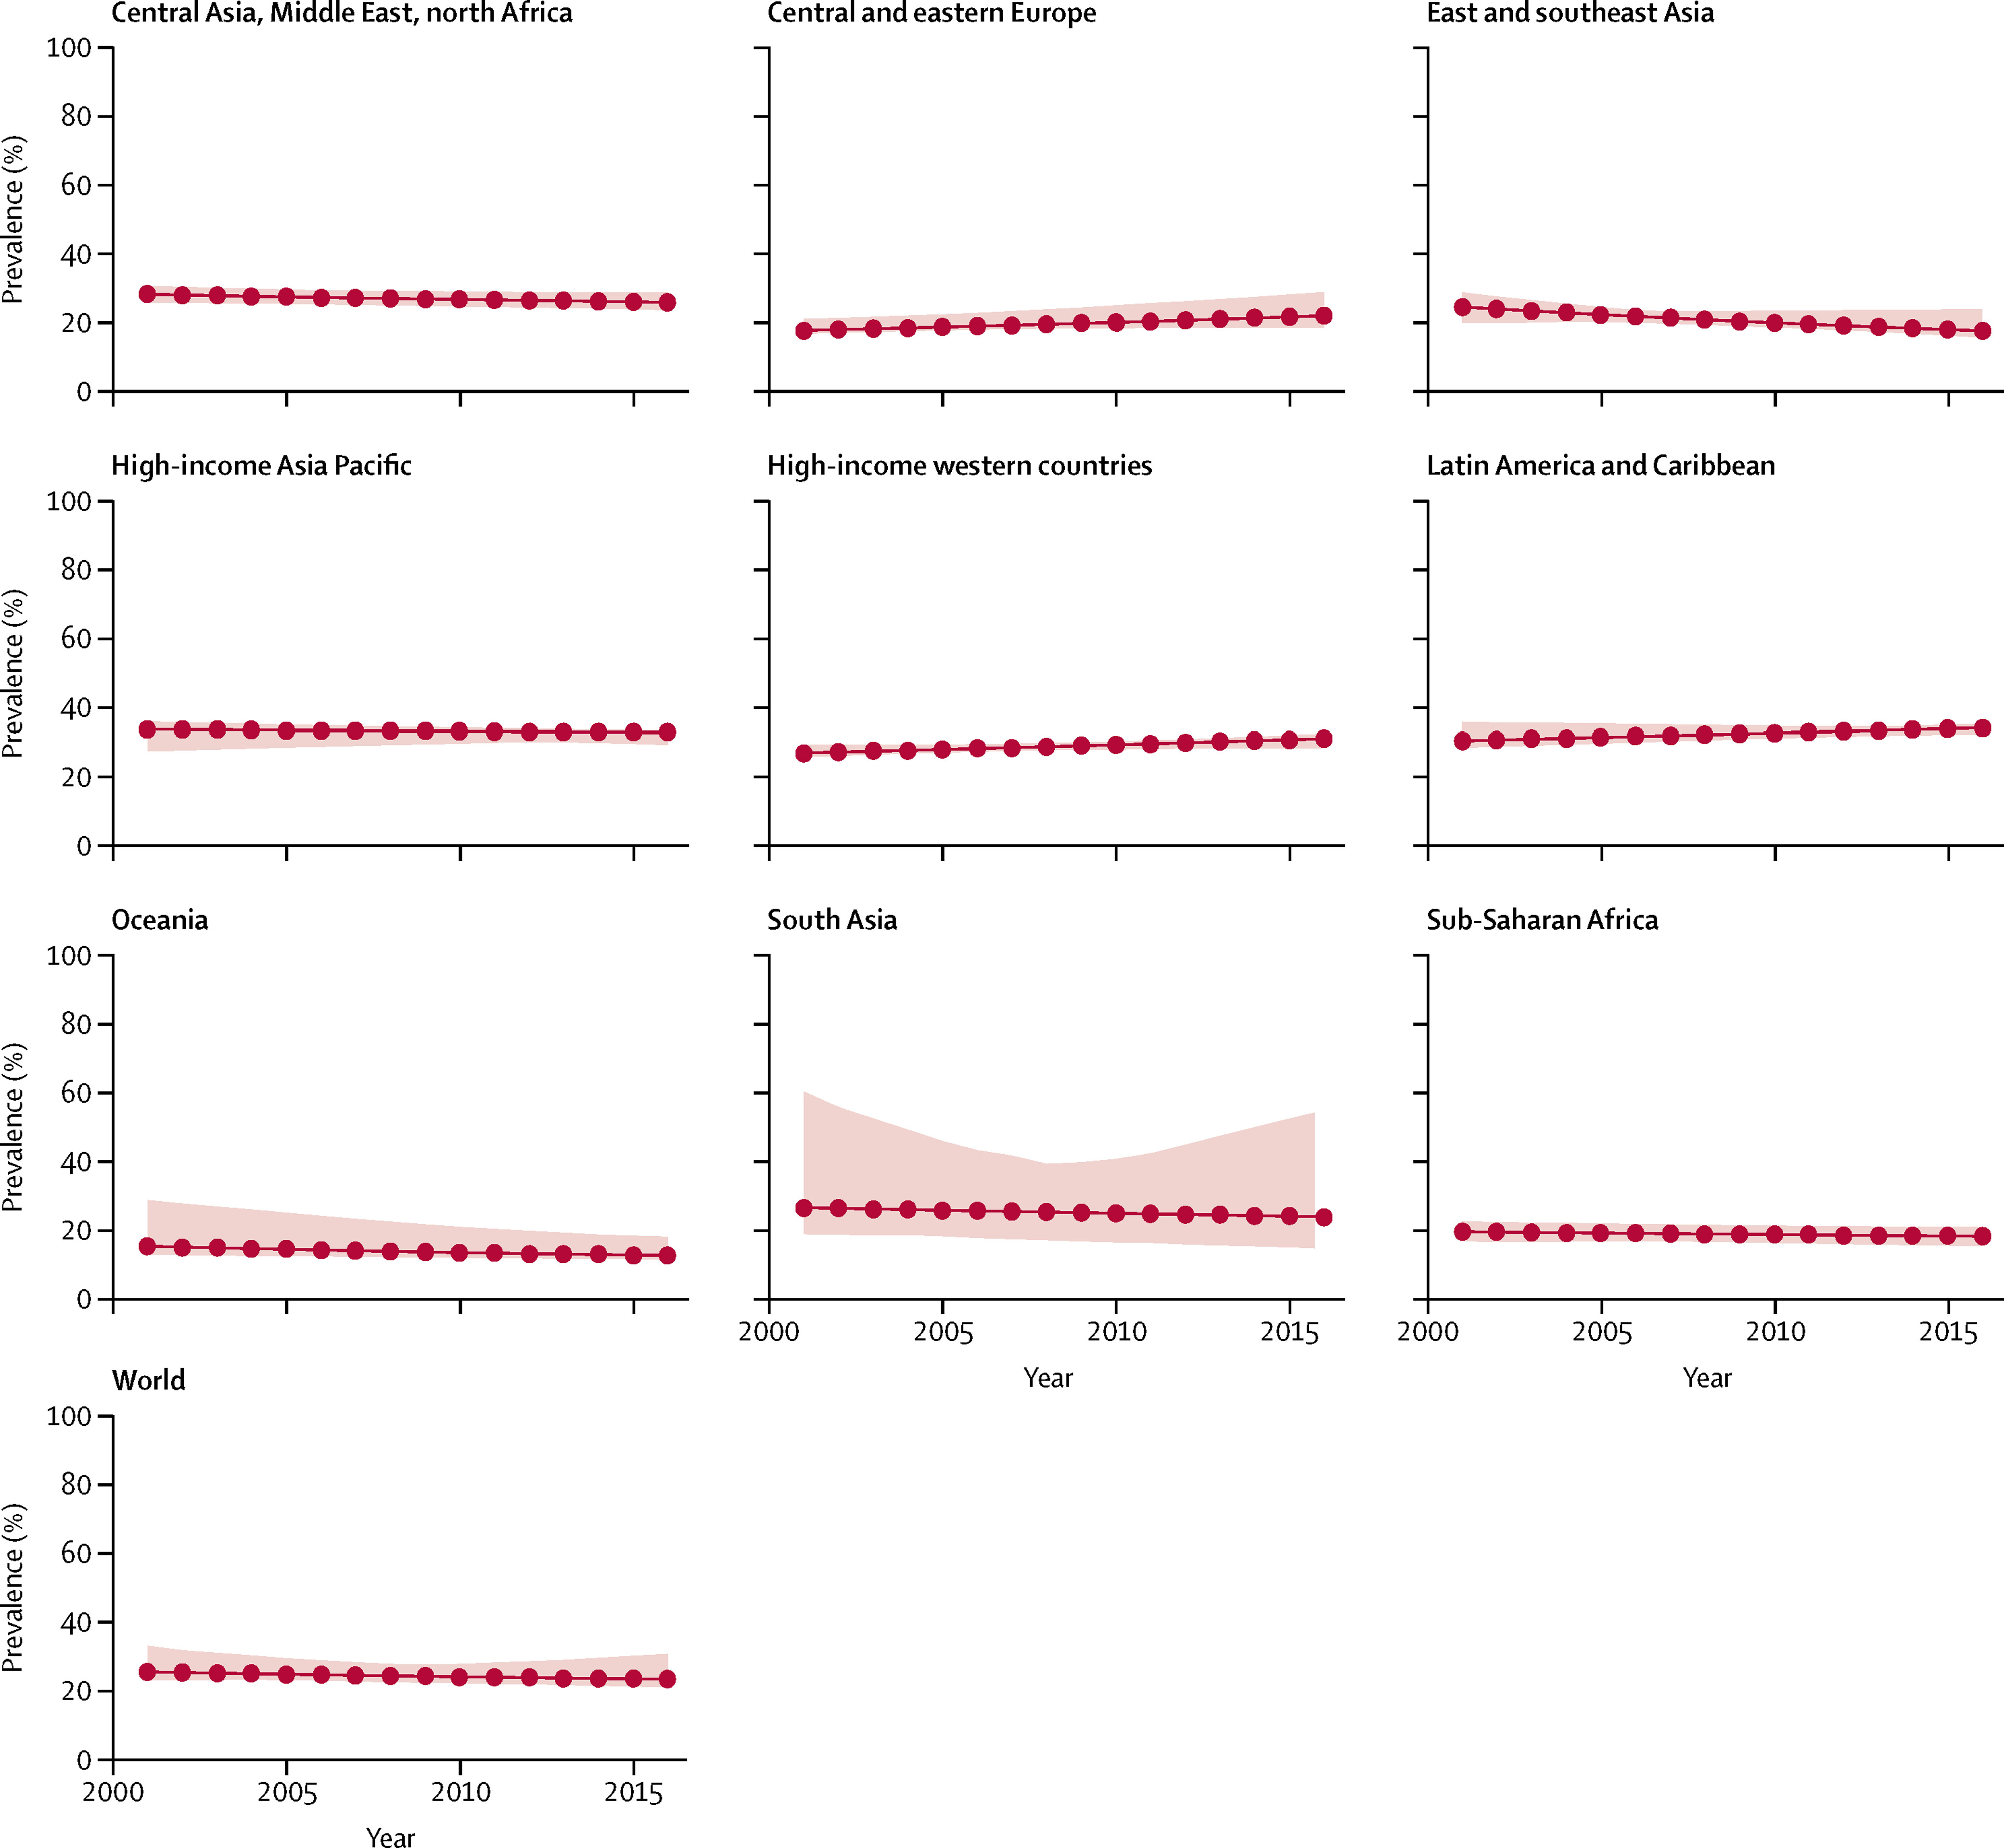
Figure 1
The Lancet Global Health 2018 6, e1077-e1086DOI: (10.1016/S2214-109X(18)30357-7)
Copyright © 2018 World Health Organization Terms and Conditions
Notes:
Trends in insufficient physical activity in men from 2001 to 2016
The shaded areas show 95% uncertainty intervals.

Slide 3
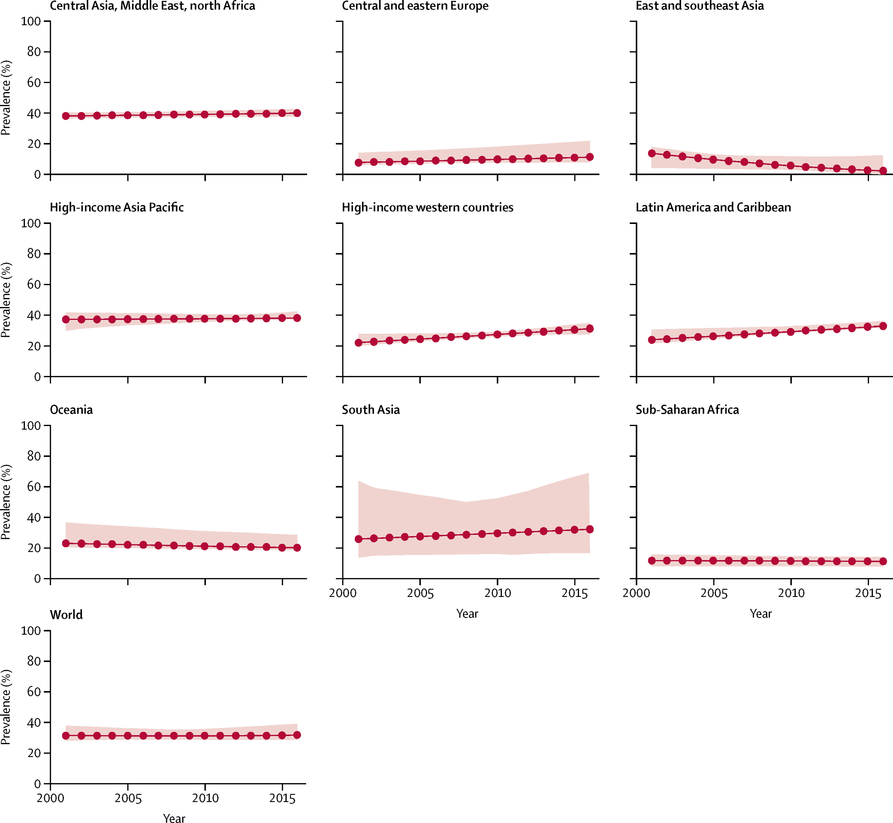
Figure 2
The Lancet Global Health 2018 6, e1077-e1086DOI: (10.1016/S2214-109X(18)30357-7)
Copyright © 2018 World Health Organization Terms and Conditions
Notes:
Trends in insufficient physical activity in women from 2001 to 2016
The shaded areas show 95% uncertainty intervals.

Slide 4
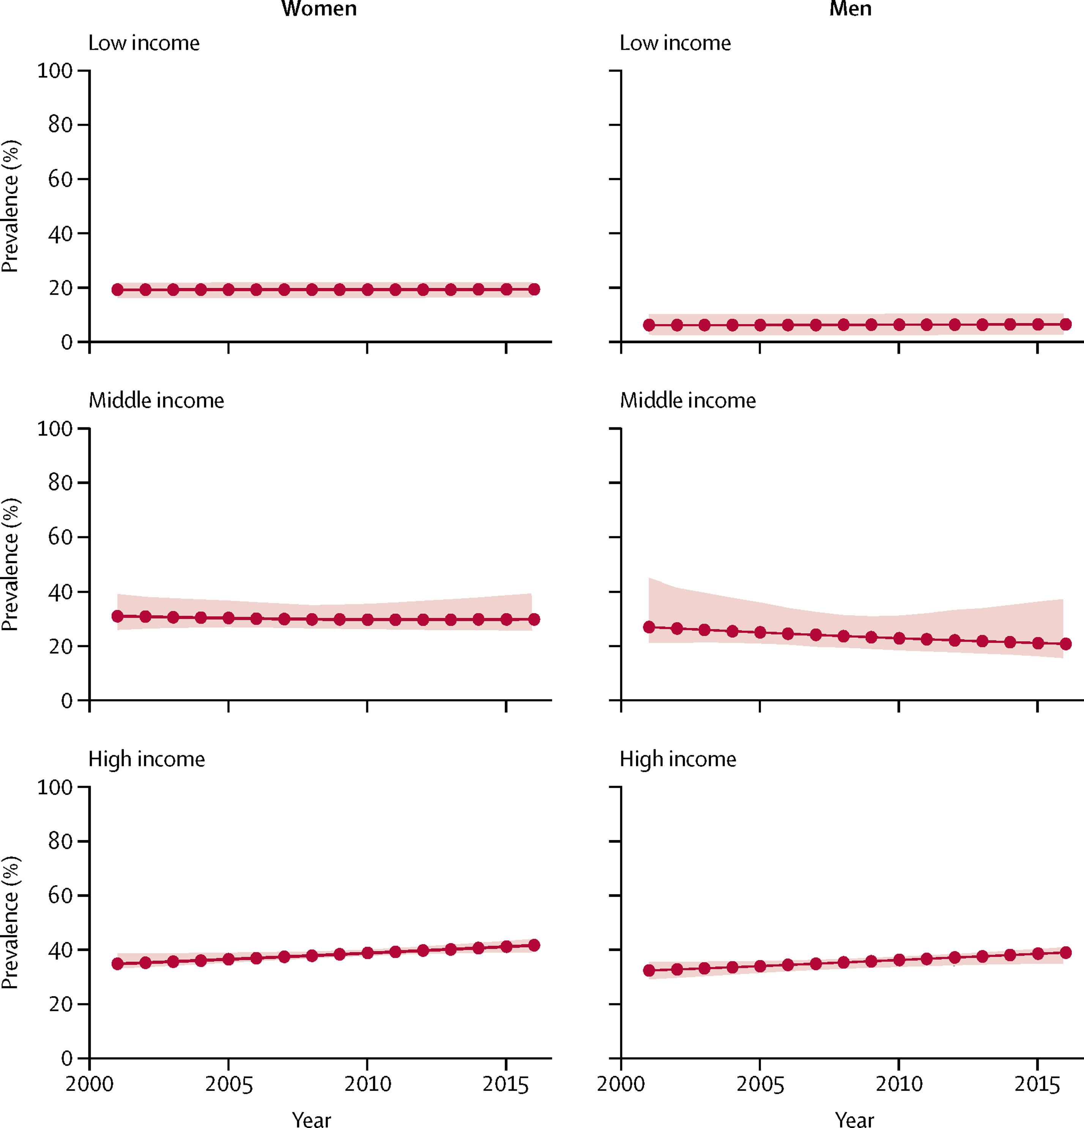
Figure 3
The Lancet Global Health 2018 6, e1077-e1086DOI: (10.1016/S2214-109X(18)30357-7)
Copyright © 2018 World Health Organization Terms and Conditions
Notes:
Trends in insufficient physical activity for three income groups from 2001 to 2016
The shaded areas show 95% uncertainty intervals.

Slide 5
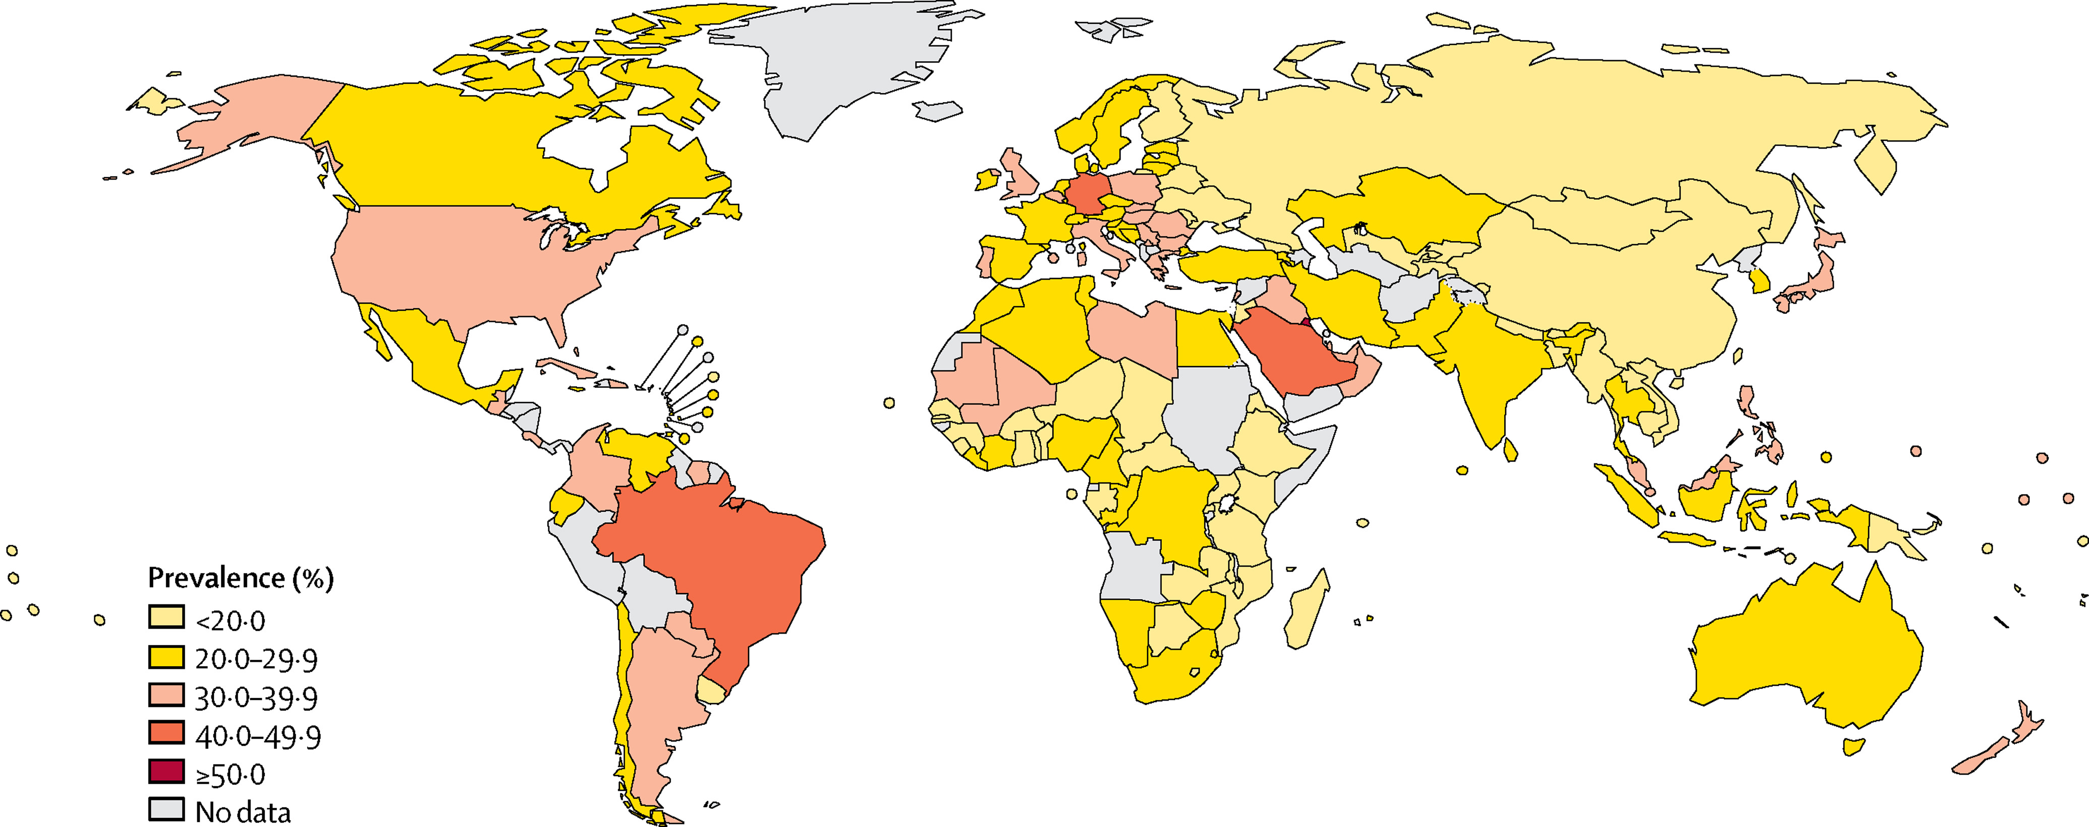
Figure 4
The Lancet Global Health 2018 6, e1077-e1086DOI: (10.1016/S2214-109X(18)30357-7)
Copyright © 2018 World Health Organization Terms and Conditions
Notes:
Country prevalence of insufficient physical activity in men in 2016

Slide 6
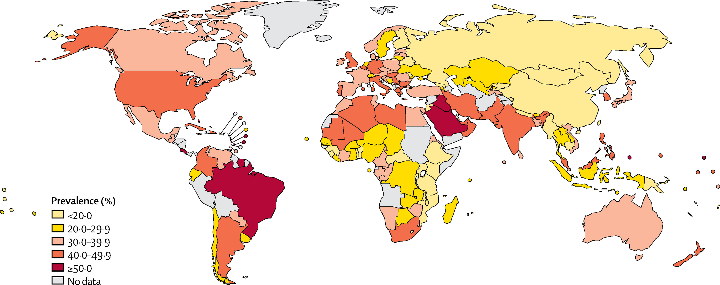
Figure 5
The Lancet Global Health 2018 6, e1077-e1086DOI: (10.1016/S2214-109X(18)30357-7)
Copyright © 2018 World Health Organization Terms and Conditions
Notes:
Country prevalence of insufficient physical activity in women in 2016

